Slide 1

Travelling into Wellness
Website created by Samantha marinier

Slide 2
Creation of website
I chose this topic because self care is important . As well incorporating a love for travelling to places. it is proven that nature helps to de cress stress levels and promote better overall wellness
Because it is a wellness travelling website I wanted to with soft colours like greens and a purple pink.
This website is sort of a hub to its other social platforms: such as our YouTube channel, Facebook , Instagram and Twitter. Users that to tag us in their nature photos to be shared will be put on the website.
Different parts of the website will link you right to the social platforms, either through the widgets at the bottom of each page or photo gallery linking to Facebook and monthly videos linking to the YouTube channel.

Slide 3
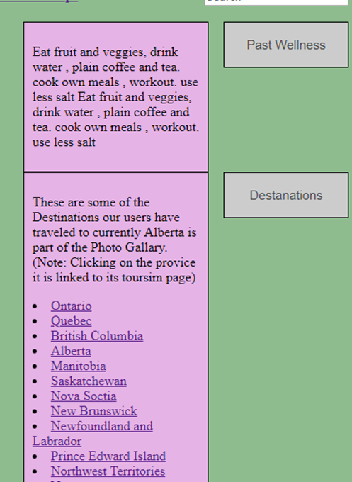
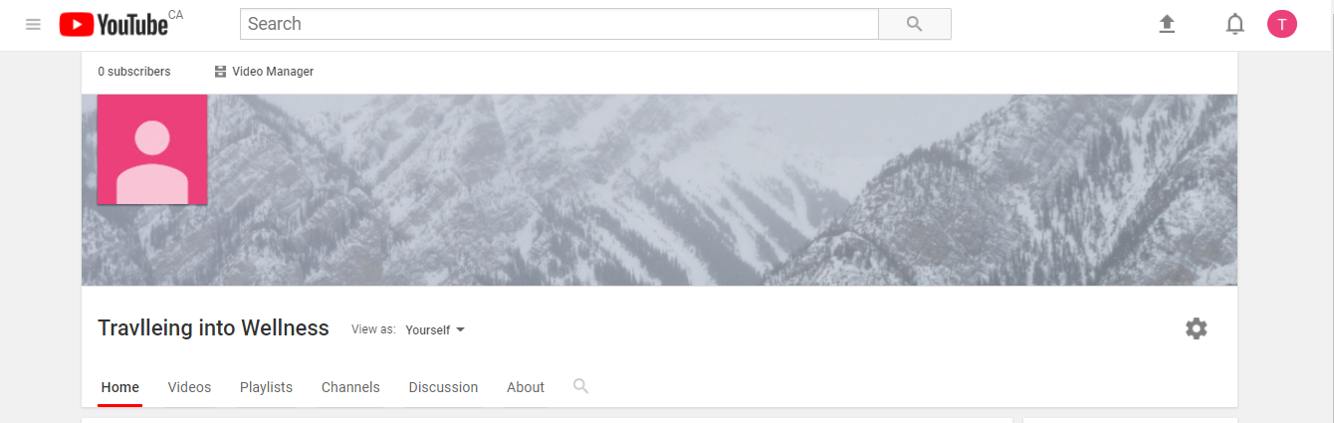
Features of the website
Our drop down menu for past tips and new destinations these link to actual tourism sites for each province.
Our YouTube channel

Slide 4


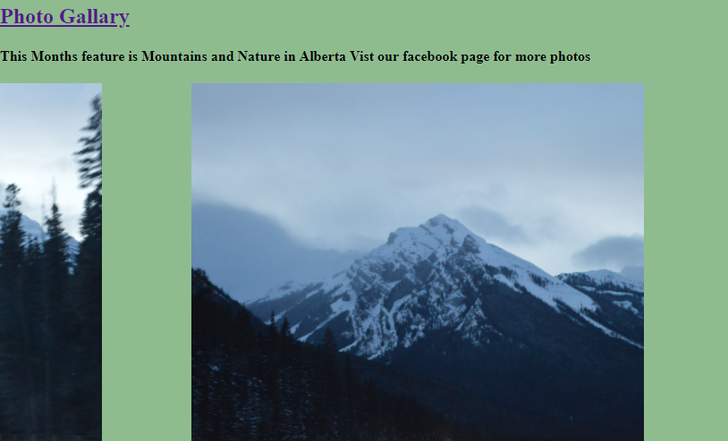
More Features
Our hamburger button going in a X when you click on it.
Our photo Gallary linking to our facebook page with more photos and our photo slider with the latest photos

Slide 5
Thank you

